Slide 1
INVENTORY MANAGEMENT SYSTEM MINI PROJECT – SEM IV
LUV ARORA – 2021003
SARWASVI INGOLEY - 2021004

Slide 2


Project analysis slide 4
Problem Definition
To build an application for managing inventory system which lets people purchase raw materials according to their needs. This inventory management system focuses on purchasing of raw materials for constructions. Admins have the management authority to keep checks in place.
Tasks
Management Objectives

Slide 3
Project analysis slide 3
SCOPE
USER LOGIN
ADMIN LOGIN
ADD
DELETE
When a user logs in, they will be only able to see the listing of the products and will be able to add them to the cart and also buy them
SEARCH
An admin can add or remove a product from the system
A user can purchase any product by adding to cart
An admin can delete a product from the product listing
We can also search a product by its name
BILL

Slide 4
Project analysis slide 2
PACKAGES USED
TKINTER
MYSQLDB
IMPORT
OS
PILLOW
TIME

Slide 5
Project analysis slide 6
DIFFICULTIES FACED
Tkinter (setting background image):
Setting up background image was difficult using frames or directly on the root object. The image would not set in the exact position with exact width and length
.
Add to Cart in user module:
Implementing Add to Cart by using tables proved to be challenging for us.
Solution: We used canvas for placing background image. Canvas is especially used for complex layouts. On top the canvas we placed our widgets like buttons or labels. .
Solution: We opted for a simpler way to implement it by using dictionaries. It was now easier to print, remove items from the cart, and print that on the bill
Logging in again after logging out in admin module:
The login window redirects to Home window after successful login completion. After logging out, it redirects back to root window from where we can login again. However, after logging in again, instead of redirecting to Home window, the program would give an error
Solution: We created another python file for the Home window and called that file using os.system() method to open it.

Slide 6
Project analysis slide 10
WORK DISTRIBUTION
Task | Luv Arora | Sarwasvi Ingoley
UI:
Design | ✓ | ✓
Coding | ✓ | ✓
Database:
Table design | ✓ | ✓
Query design | ✓ | ✓
Coding | ✓ | ✓
Program:
Admin Module |  | ✓
User Module | ✓
Add to Cart / Buy Now Module | ✓ | ✓
Testing:
Test Cases | ✓ | ✓
Presentation:
Report |  | ✓
PowerPoint | ✓

Slide 7
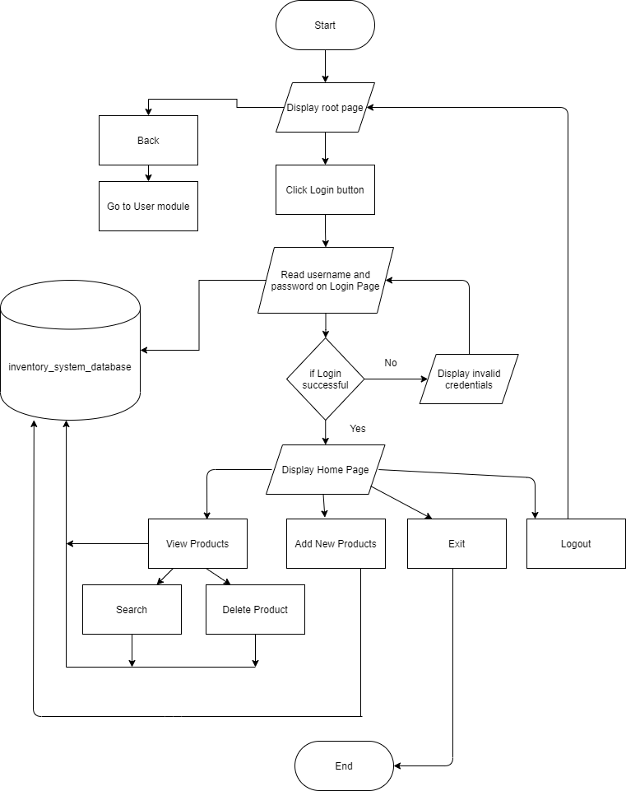
Project analysis slide 5
ADMIN MODULE

Slide 8
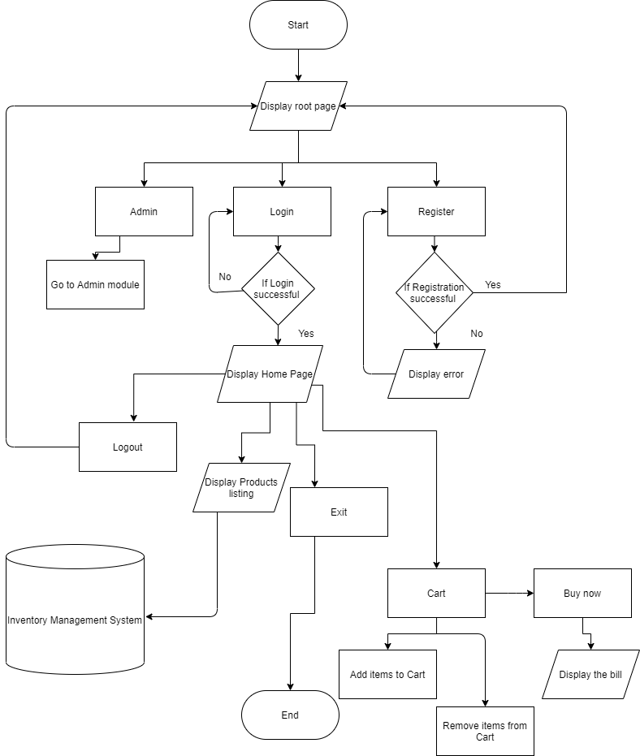
Project analysis slide 7
USER MODULE

Slide 9
Project analysis slide 8
FUTURE SCOPE
User Specific Add To Cart: If the user logs in again the add to cart functionality will remain unchanged.
Saving the Bill: After the bill is produced a screenshot of the bill is taken and stored in the form of pdf in the backup directory.
CONCLUSION
Thus, we have understood all the concepts taught to us during this course. We implemented most of the concepts and got a deeper understanding of the subject. We have even learnt some new concepts and applied in our Mini Project.

Slide 10
Thank You

